Slide 1
CSCI222 – Assignment 1 presentation
By Group B4

Slide 2
Group Members
Nguyen Duc Anh
William Wunady
Ardyanto
Wu Chin Hwa

Slide 3
Project Overview
A country club is looking for our help to build Country Club Facilities Booking System (CCFBS) in C++ or Java.
But first, we have to finish all the class diagrams.
This project is done with the help of RUP (Rational Unified Process).
The coding will be done in Assignment 2.

Slide 4
The First Step
We decided to hold our first group meeting on the 16th of January, 2016.
The results include :
Using TortoiseSVN as our versioning system.
Using Facebook Chat for our online communications.
Clarifying the visions and missions of our project.
Defining the roles of each and every group member.

Slide 5
Our Vision
Main task :
Create CCFBS.
Allow club members to search/book facilities.
Allow club managers to manage facilities.

Slide 6
Our Vision (.cont)
Scope and Feature :
Club members can book/search facilities and update their personal information.
Club managers can manage members’ rankings and facilities (including creating/editing/deleting).
Admins can add/delete users and managers.
Constraints :
A virtual database for storing information of club members, managers, facilities and booking information.
The product should have a basic GUI.

Slide 7
Member Roles and Responsibility
No. | Member Name | Role | Artefacts
1 | Nguyen Duc Anh | Project Manager, Sub Designer | Use Case diagram, Class Diagram, Comp. diagram, part of SRS, project planning
2 | William Wunady | Sub. Manager, Analysis | SRS, project planning and scheduling, part of other diagrams
3 | Ardyanto | Designer, sub analysis | Use Case diagram, Activity Diagram, Cases analyzing
4 | Wu Chin Hwa | Analysis, sub designer | Use Case diagram, Activity Diagram, Risk analyzing

Slide 8
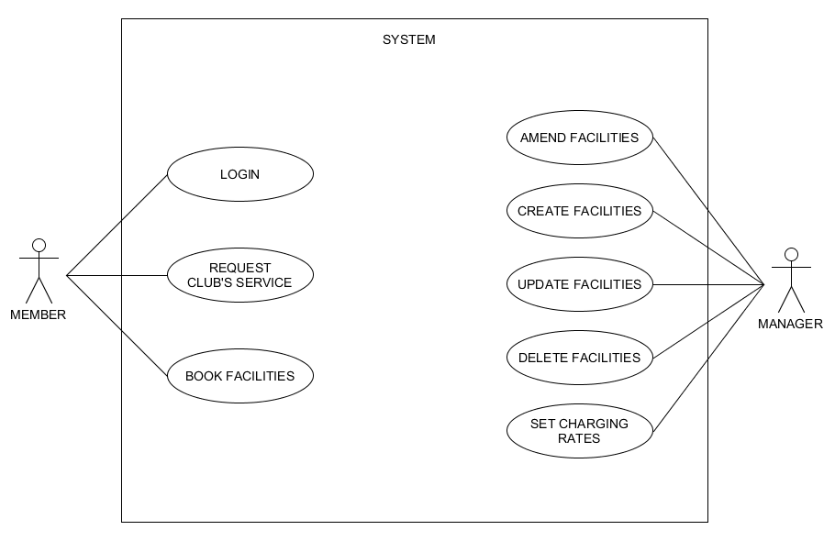
Initial Use Case Model

Slide 9
Initial Use Case Model (Explanation)
Based on our initial understanding of the system.
Shows managers and members’ roles in the system.
Still barebones. Needs to be analysed further.

Slide 10
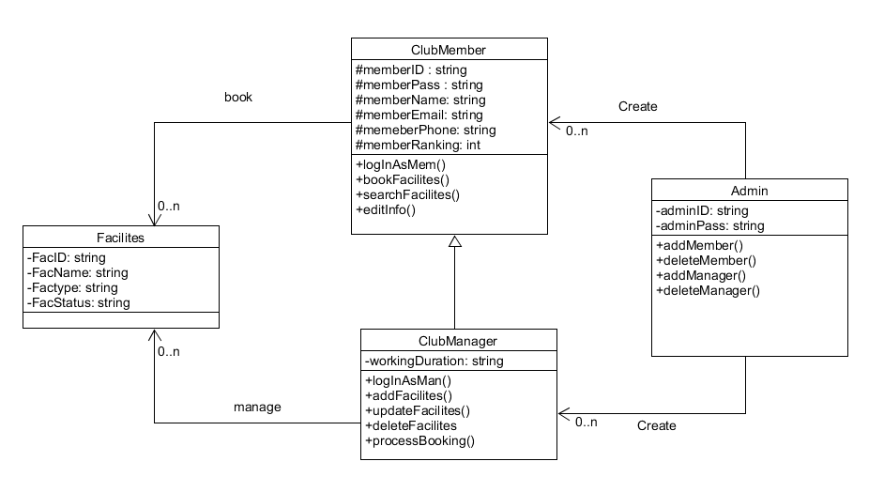
Some Brainstormings Later…
This is our v1 Class Diagram.

Slide 11
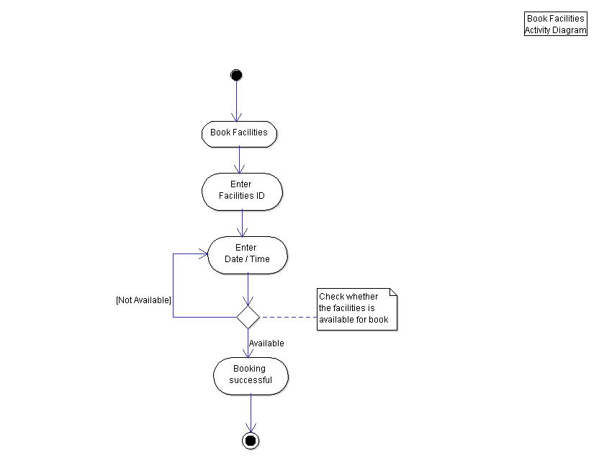
Some Brainstormings Later…
This is one of our v1 Activity Diagrams (on club member wanting to book facilities).

Slide 12
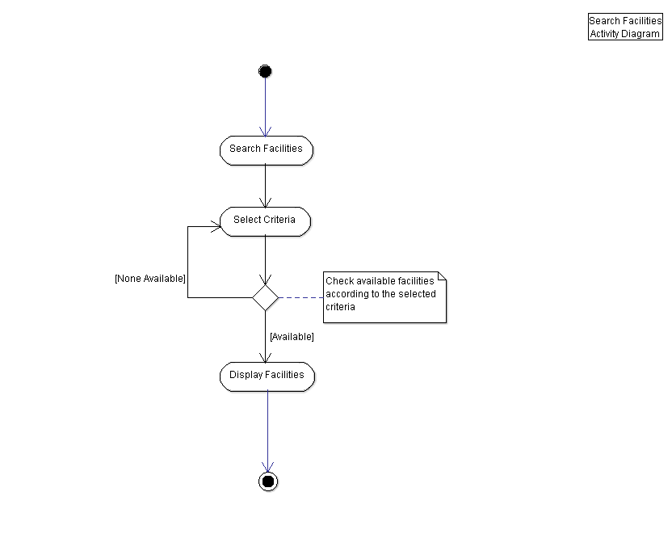
Some Brainstormings Later…
This is one of our Activity Diagrams (on club member wanting to search for facilities).

Slide 13
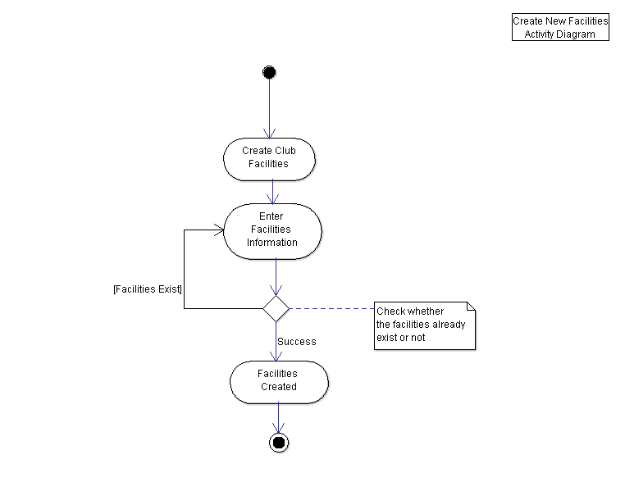
Some Brainstormings Later…
This is one of our Activity Diagrams (on club member wanting to Create facilities).

Slide 14
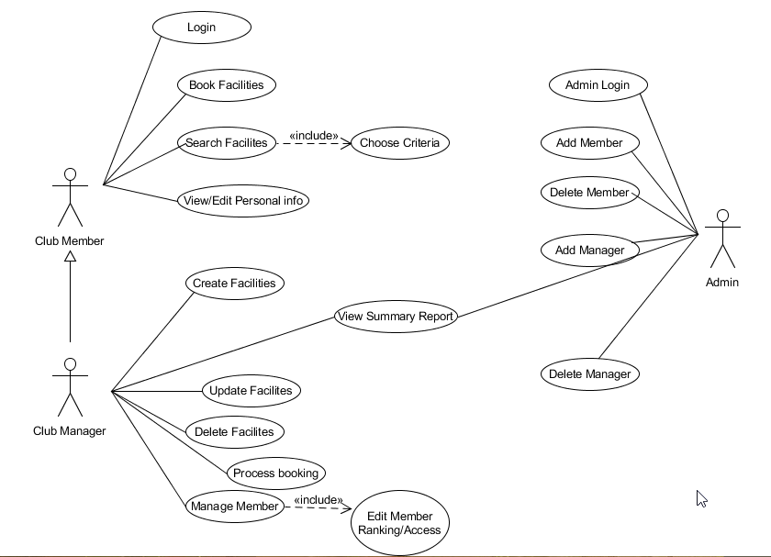
Some Brainstormings Later…
This is our updated Use Case Diagram.

Slide 15
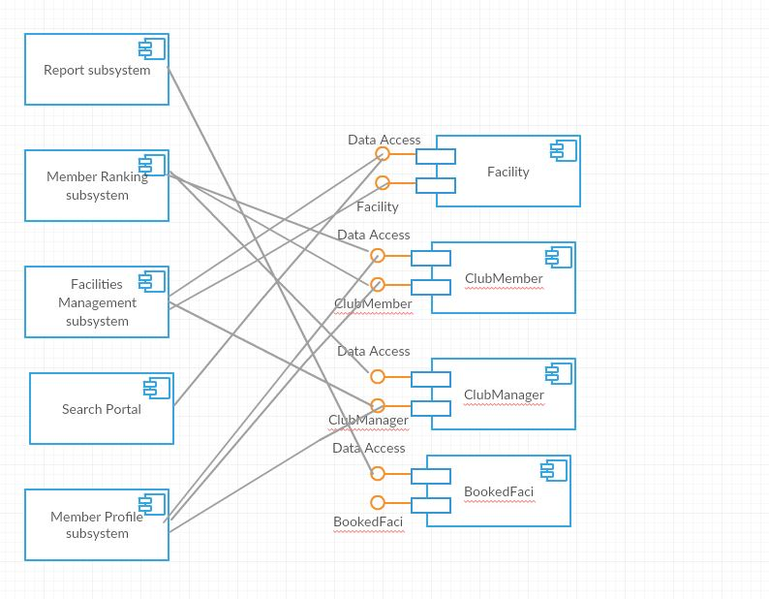
Some Brainstormings Later…
This is our v1 Component Diagram.

Slide 16
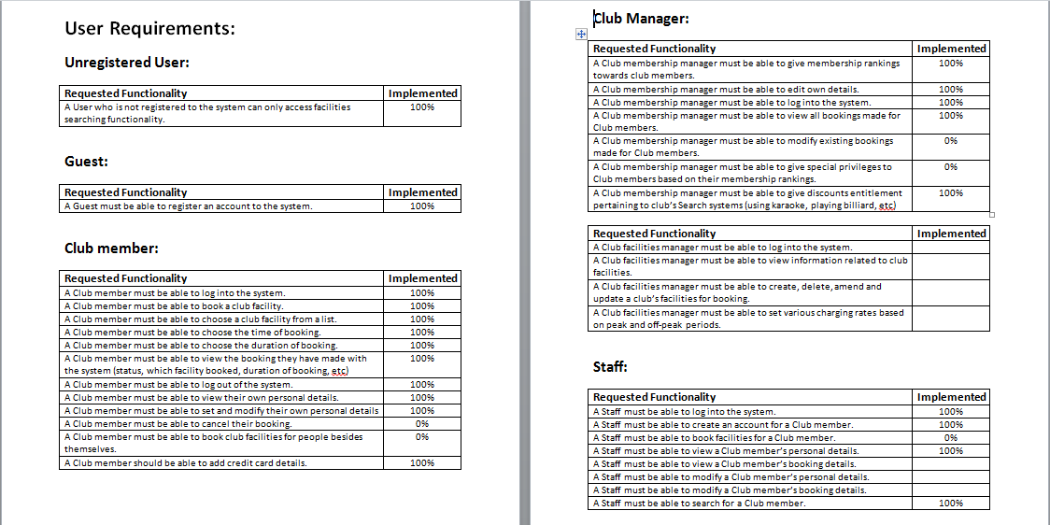
Some Brainstormings Later…
This is our v1 Requirements List.

Slide 17
Problems
The Use Case Diagram is fine, but…
The Class Diagram is still unfinished.
The Component Diagram doesn’t fulfill the constraint (where’s the server and database?).
The Requirements List is too big and assumed wrongly (such as the presence of generic staff).
Therefore, these issues have to be discussed further in our second group meeting.

Slide 18
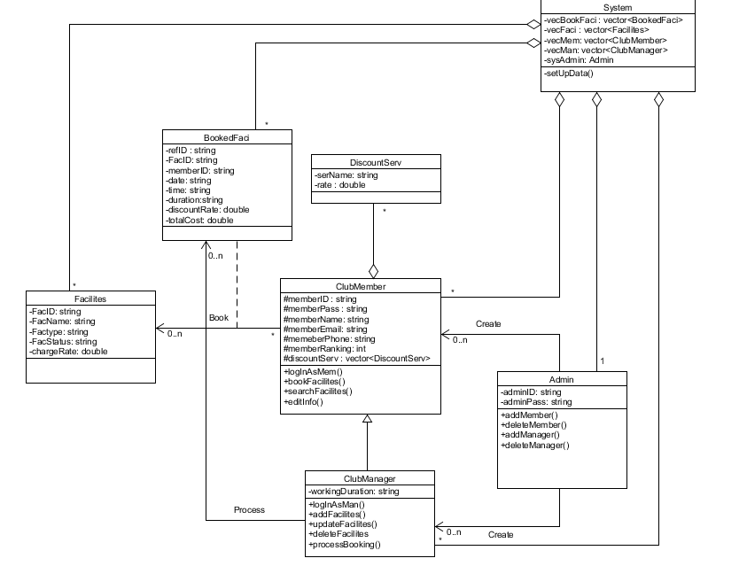
After Fixing Mistakes…
This is our final Class Diagram.

Slide 19
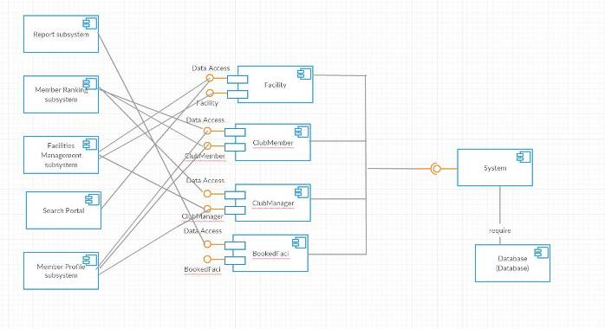
After Fixing Mistakes…
This is our final Component Diagram.

Slide 20
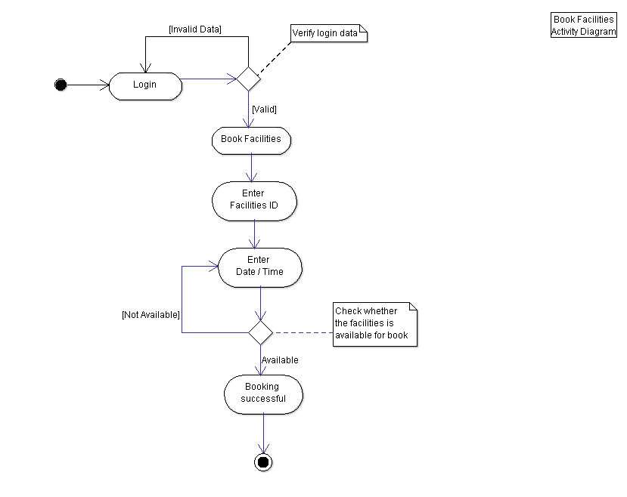
After Fixing Mistakes…
This is the final version of one of the Activity Diagrams seen some slides before.

Slide 21
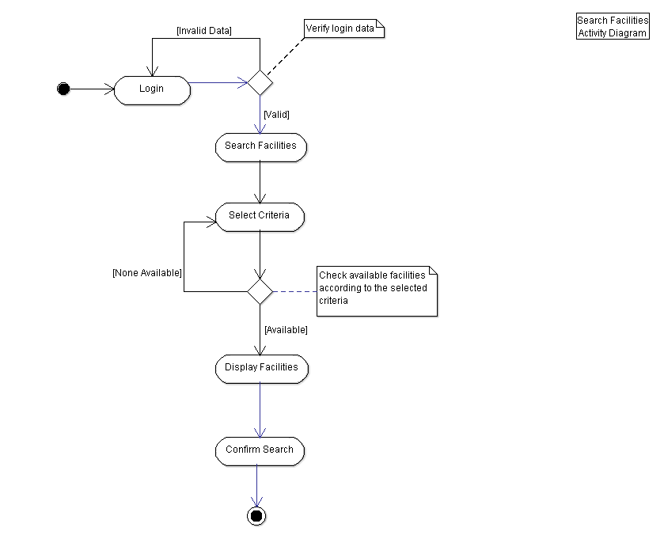
After Fixing Mistakes…
This is one of our Activity Diagrams (on club member wanting to search for facilities).

Slide 22
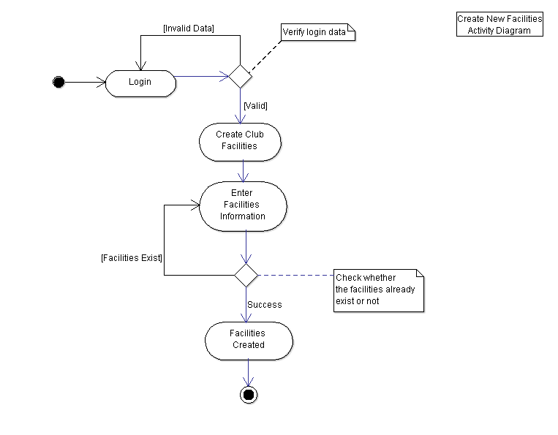
After Fixing Mistakes…
This is one of our Activity Diagrams (on club member wanting to Create facilities).

Slide 23
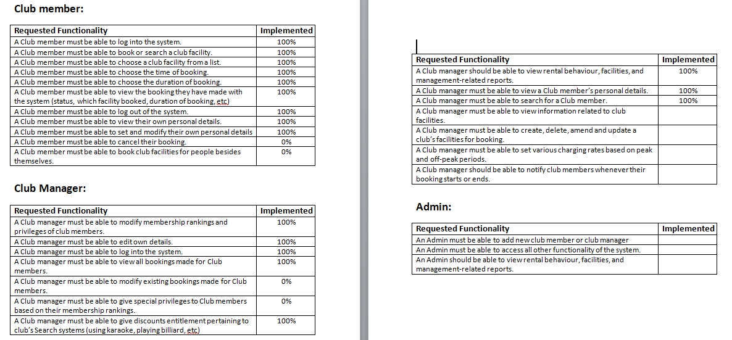
After Fixing Mistakes…
This is our final Requirements List.

Slide 24
3rd and Final Group Meeting
After cross-checking our work between each other, we deemed it to be good enough for the project.
Now we are left with making the SRS (since we have done the Requirements List already) and the reports.
We also compiled the materials to include in our presentation.

Slide 25
Reports Included
Reports included are :
Detailed use case scenarios for each actor.
Project Risk Analysis and Management.
SVN Reports (Evidence of the usage of VCS).
Individual member work diaries.
Reports of all three group meetings.
Detailed Project overview and plans.
SRS (System Requirements Specifications).
Can see to each individual documents for details.

Slide 26
And that concludes our presentation.
We hope you enjoy watching through it.

